Slide 1
Cloud Computing & Cloud Storage
By Jack Stewart

Slide 2
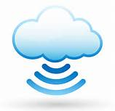
The Cloud
Cloud computing, or something being in the cloud, is a colloquial expression used to describe a variety of different types of computing concepts that involve a large number of computers connected through a real-time communication network such as the Internet. Cloud computing is a term without a commonly accepted unequivocal scientific or technical definition. In science, cloud computing is a synonym for distributed computing over a network and means the ability to run a program on many connected computers at the same time.

Slide 3
http://www.youtube.com/watch?v=TTNgV0O_oTg

Slide 4
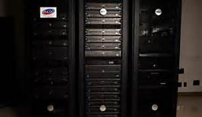
Cloud storage
Cloud storage is where data is stored pools of storage usually hosted by third party companies. The companies have large centres where people can buy or use free storage space to store data files or data objects. It can span from multiple locations and multiple servers.

Slide 5
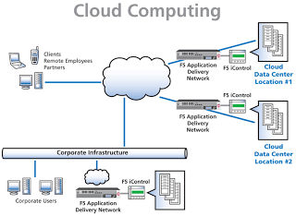

Slide 6
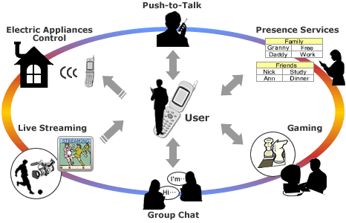
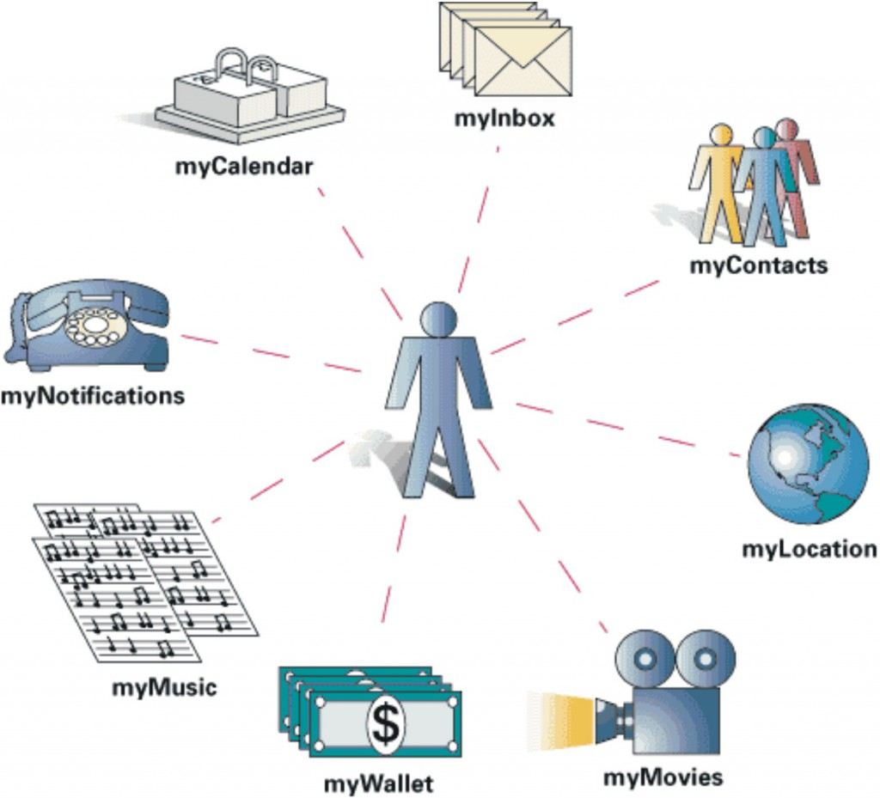
Ubiquitous Computing
Ubiquitous computing, or ‘the internet of objects’, describes how computers are embedded into all sorts of sorts of objects we use in our daily lives, such as cars, kitchen appliances and even clothes. Ubiquitous means ‘existing everywhere’. Processors can be embedded in any devices to connect them to the internet so that the data generated by the processors will be readily available.

Slide 7
RFID’S
Radio-Frequency identification (RFID) is the wireless non-contact use of radio-frequency electromagnetic fields to transfer data, for the purposes of automatically identifying and tracking tags attached to objects.
Examples of RFID’s
Animals (to monitor population)
Animals (to find and monitor where they are)
Clothes (to make sure no ones stealing)
Farming (keep track of cattle)
Navigation (GPS)

Slide 8
Thanks for watching!!!!!!!!!

